Slide 1




AUTISM SPECTRUM DISORDER DETECTION
USING MACHINE LEARNING
PRESENTED BY
NAME:
USN:
UNDER THE GUIDANCE OF
PROF:
DEPT OF CSE

Slide 2

AGENDA
ABSTRACT
INTRODUCTION
AIM & OBJECTIVE
LITERATURE SURVEY
EXISTING SYSTEM
PROPOSED SYSTEM
.
SYSTEM DESIGN
SYSTEM REQUIRMENT SPECIFICATIONS
FUTURE SCOPE
REFERENCES

Slide 3
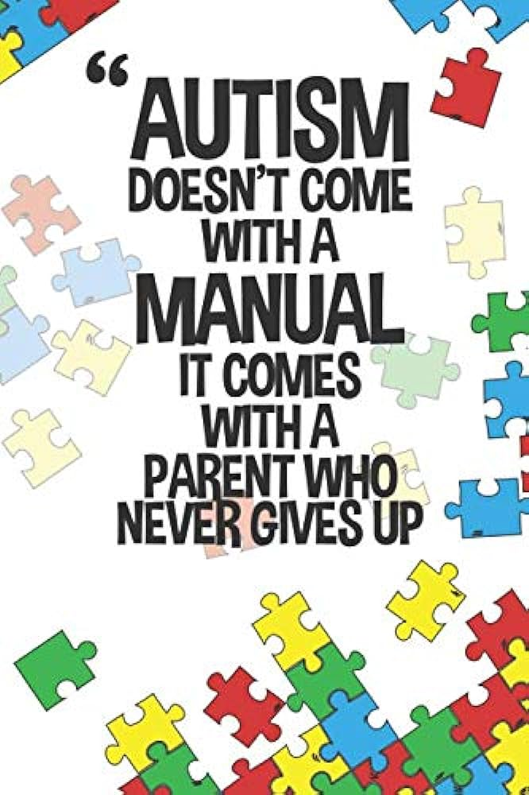
ABSTRACT
  It is always a complex procedure to diagnose autism spectrum disorder (ASD) because there is no particular medical test for autism, like a blood test, to make a diagnosis for the disorder.
  Autism spectrum disorder is defined by the disability and impairments of participating in social communication or the presence of restricted or repetitive behaviours, or both.
  It is a behaviourally diagnosed condition. To make a diagnosis, doctors look at the child's developmental history and behavior. Apparently, most children do not attain a proper diagnosis for autism until it is too late.
  So, we are developing a system that will have the ability to diagnose Autism and come up with a reliable and effective conclusion even without the help of a professional. We hope this system will be very helpful for those concerned parents who are worried about their child's growth and activities, at the same time it will be very useful for the professionals.
Notes:
B

Slide 4
INTRODUCTION
Autism, formally known as Autism Spectrum Disorder (ASD), is a complex neurodevelopmental condition that affects individuals in various ways. It is characterized by a wide range of symptoms and challenges that primarily impact social interaction, communication, and behavior
Autism is often described as a "spectrum" disorder because it manifests differently in each person, with varying degrees of severity and a diverse array of strengths and difficulties. Autism typically becomes apparent in early childhood, often before the age of three. However, it can continue to influence an individual's life throughout their lifespan.
While the exact cause of autism remains the subject of ongoing research, it is believed to result from a combination of genetic and environmental factors. Some common features of autism include: Social Challenges: Individuals with autism may have difficulty with social interactions, including understanding social cues, maintaining eye contact, and forming relationships. Communication Difficulties: Many people with autism experience challenges in verbal and nonverbal communication.
Autism awareness and acceptance are crucial in promoting inclusivity and ensuring that individuals with autism are given the opportunities they deserve to reach their full potential.
In recent years, machine learning has acquired many achievements and it is gaining more importance in applied sciences such as medicine and biomedicine. In clinical decision making and diagnostics, machine learning methods are used or recommended to support data interpretation. Therefore, methods of screening diseases with the aid of machine learning are extensively studied.
Notes:
B

Slide 5
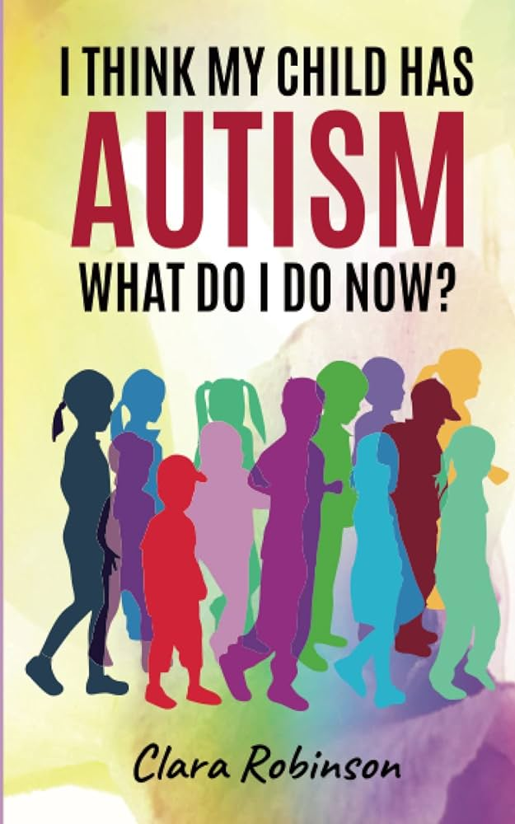
AIM & OBJECTIVE
The main objective is to develop an application which can allow the user to be able to find out whether he/she may have chances of being Autistic. Other objectives of this application is to be able to satisfy the need for early detection of Autism and provide necessary details about such a medical condition. The application also consists of available doctors who specialize in certain fields, this can be vital and informative to the user. Our aim is to make this web application user friendly and accessible.
Objectives:
The dataset Collection for Autism Spectrum Disorder Dataset from various sources.
Data cleaning, Visualization and Feature Extractions
Distinct machine-learning classification algorithms were used to build a classifier to predict the Disease.
Modelling the data with classifiers
Performance Evaluation and Predictions
Building a web application to demonstrate the output.
.
.
.

Slide 6
EXSITING SYSTEM
.
The major part of the existing literature on autism spectrum disorder is covered by a prediction system based on traditional machine learning algorithms such as Linear Regression, Logistic Regression, multiple layer perceptron and deep neural network.
Using these machine learning model achieving very less accuracy such 67 to 72% with less precision, recall and F1 Square.
.
.

Slide 7
PROPOSED SYSTEM
In this Project, autism spectrum disorder prediction has been investigated and compared using common parameters such as application type, simulation method, comparison methodology, and input data.
The key purpose of this study is to give a centralized framework to use for researchers working on autism spectrum disorder prediction.
Here we developed Random Forest, Support vector machine and KNN Algorithm to achieve good performance and evaluation of the model.
The proposed models are validated by using performance measurement parameters such as accuracy, precision, and recall.
Notes:
B

Slide 8
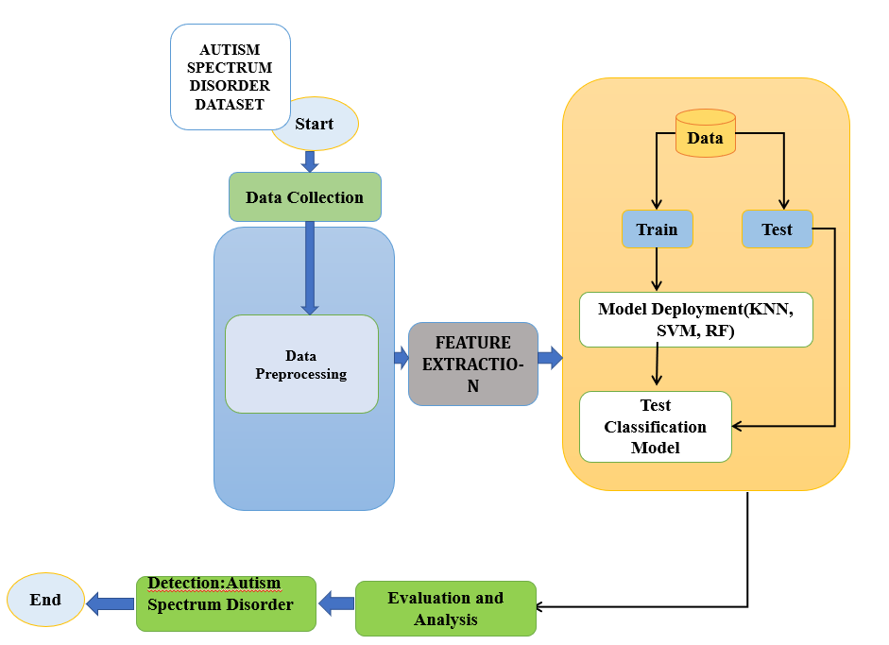
Notes:
B

Slide 9
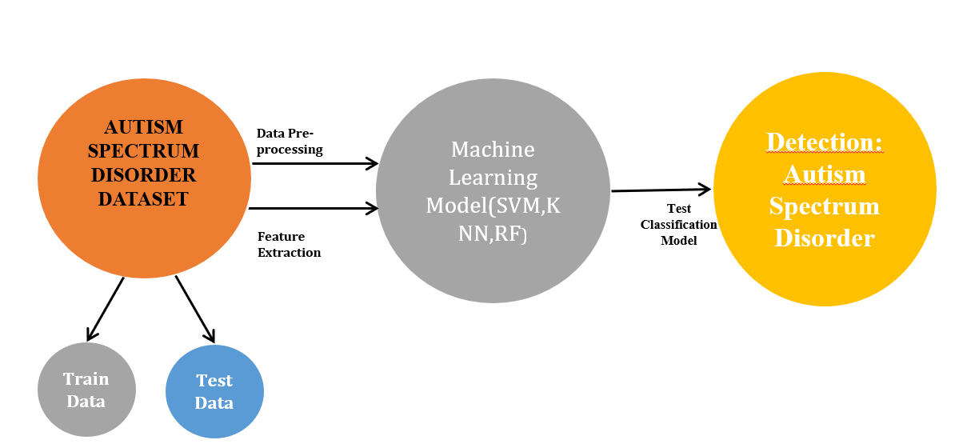
SYSTEM DESIGN – DATAFLOW DIAGRAM-LEVEL0
Notes:
B

Slide 10
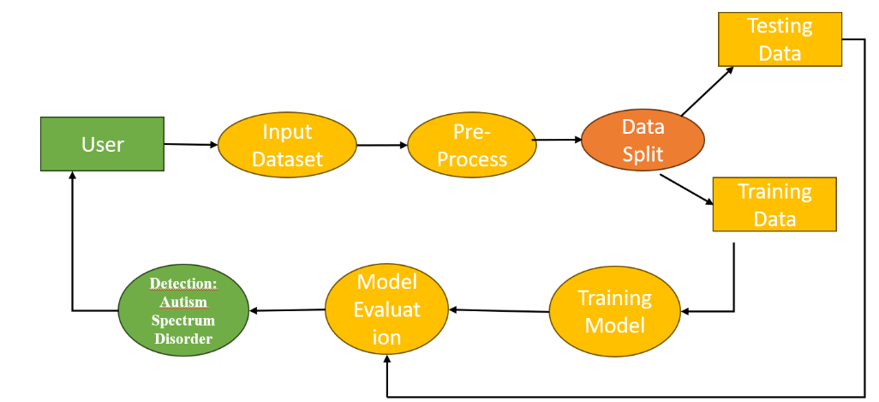
SYSTEM DESIGN – Dataflow Diagram-LEVEL1
Notes:
B

Slide 11
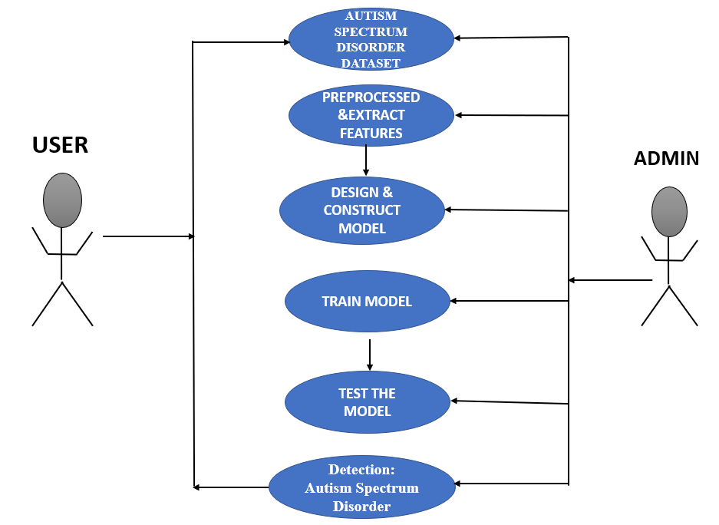
SYSTEM DESIGN – USE-CASE DIAGRAM
Notes:
B

Slide 12
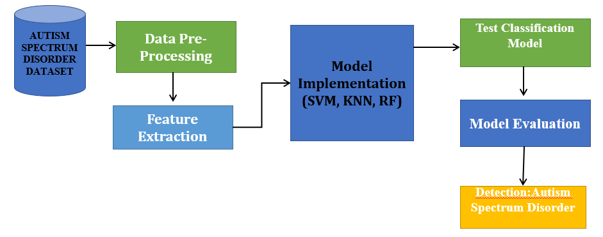
METHODOLOGY
Notes:
B

Slide 13
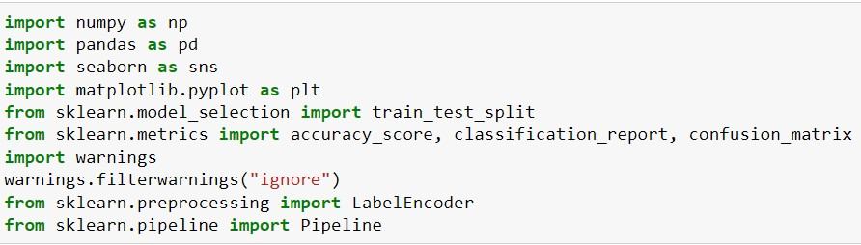
SYSTEM IMPLEMENTATION
Code Implementation
Importing Packages
Install and import the entire package required for the project. Here, we used Numpy, pandas used for the data frame, Matplotlib, Seaborn used for data visualization and Sklearn used from machine learning.

Slide 14
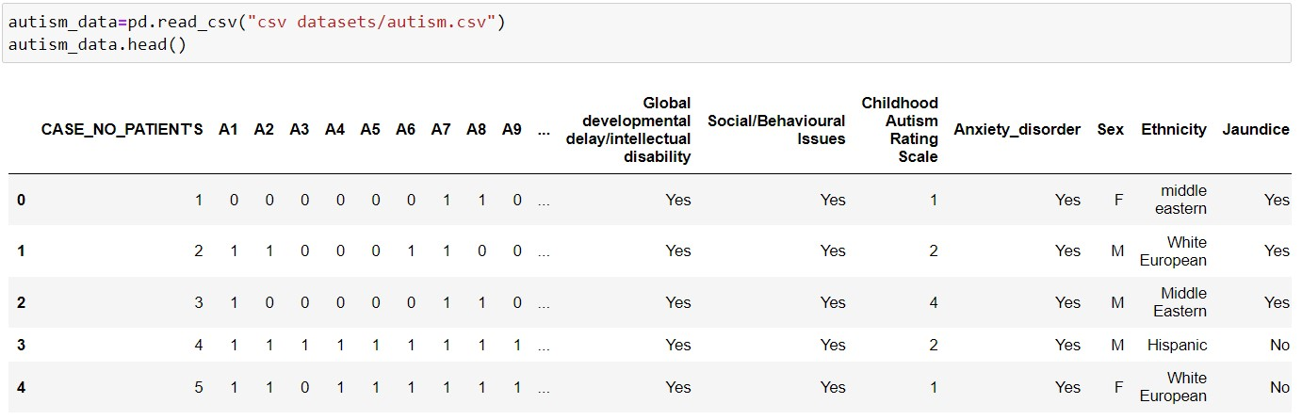
Upload Dataset
We used Autism Dataset for prediction system. Gather data related to autism, including information about the symptoms and user sentiments or reviews associated with them. There are various sources to consider, such as online review platforms, medical forums, or social media.

Slide 15
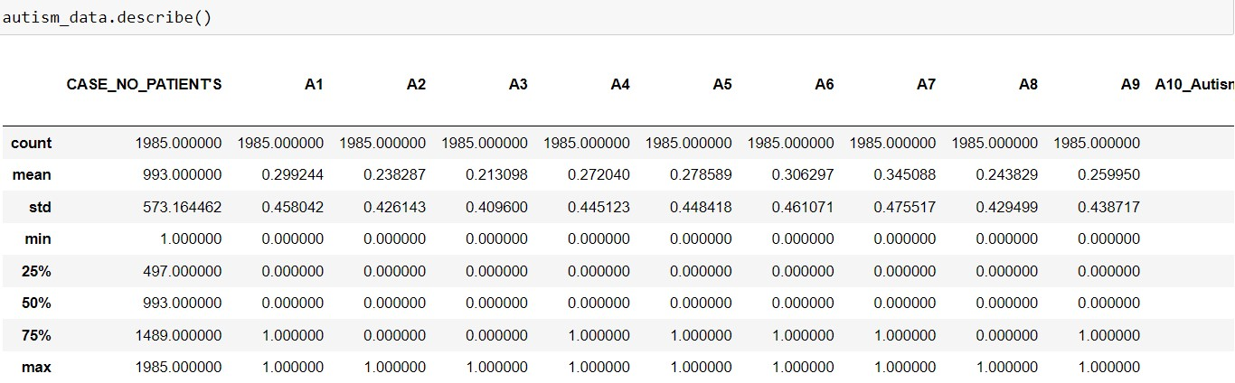
Data-preprocessing
Clean and pre-process the collected data. This may involve removing irrelevant information, handling missing data, standardizing text formats, and performing other necessary pre-processing tasks and also label encoding.
Describing the data

Slide 16
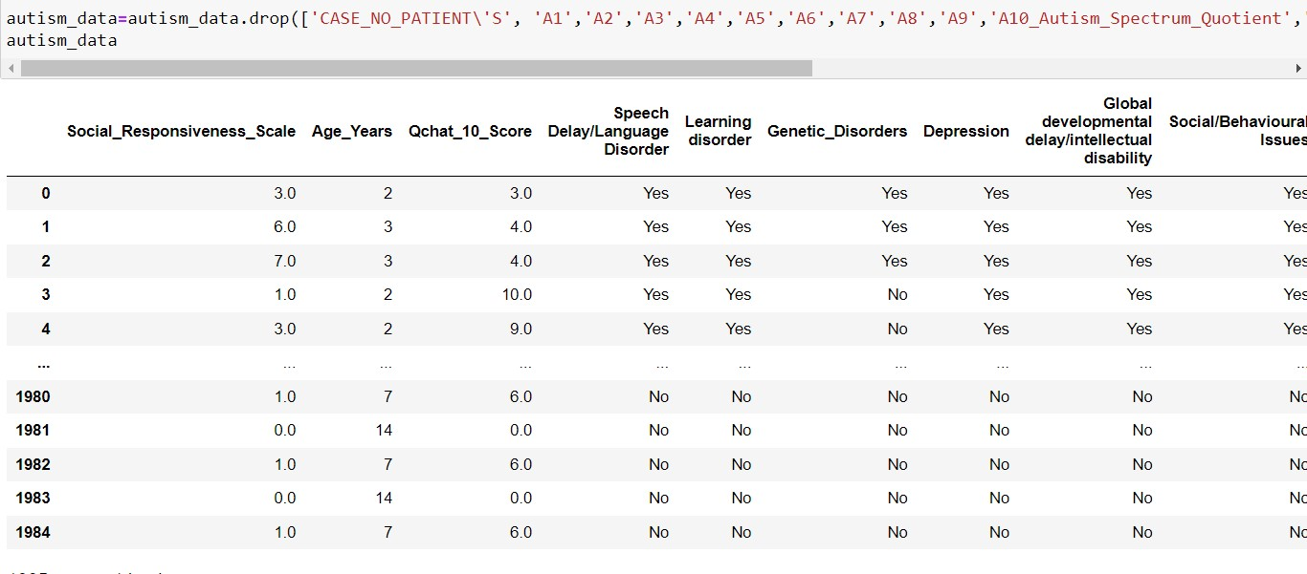
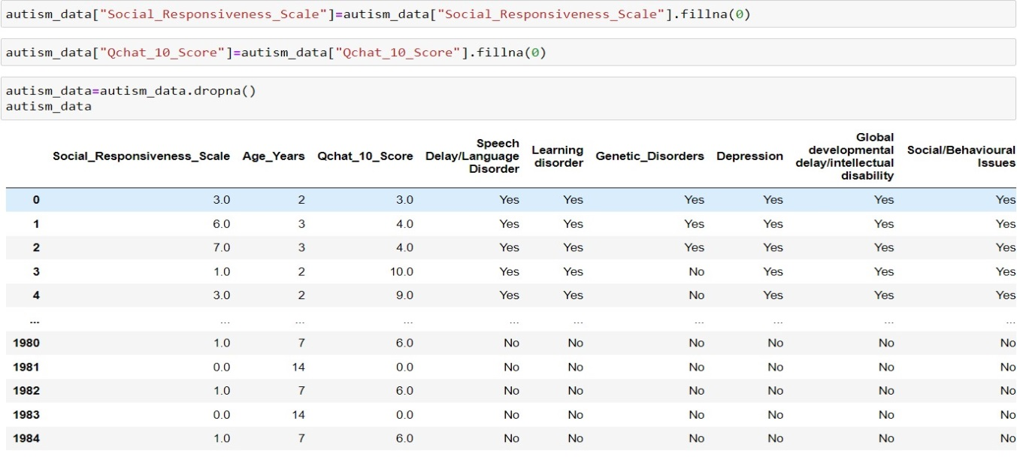
Dropping irrelevant columns
Checking null values

Slide 17
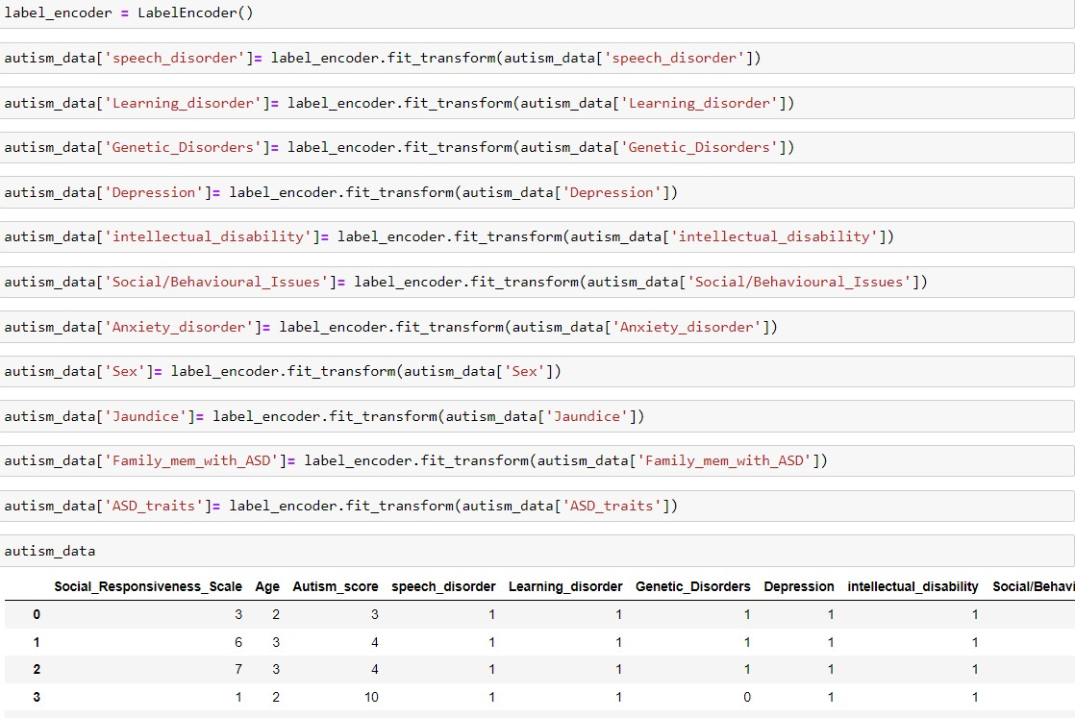
Label Encoding

Slide 18
Analysis on Dataset
Notes:
B

Slide 19
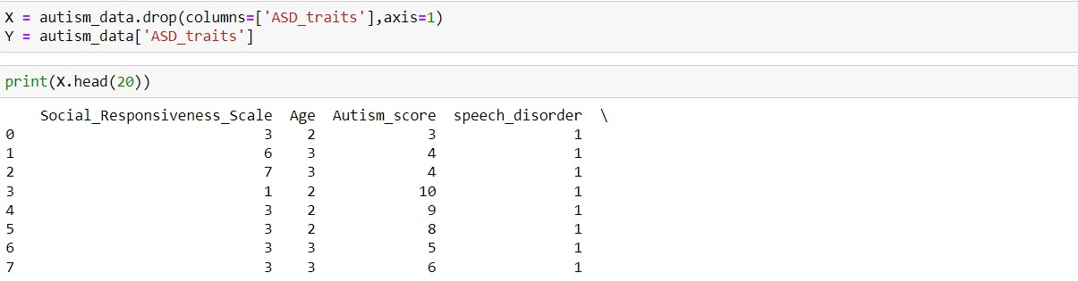
Building Machine Learning
Build a recommendation model that takes the extracted features as input and generates drug recommendations based on the sentiments. Here we used Machine Learning algorithm like Logistic Regression, Decision Tree Classifier, Linear SVM, GaussianNB and Random Forest Classifier
Splitting Dataset into training and testing

Slide 20
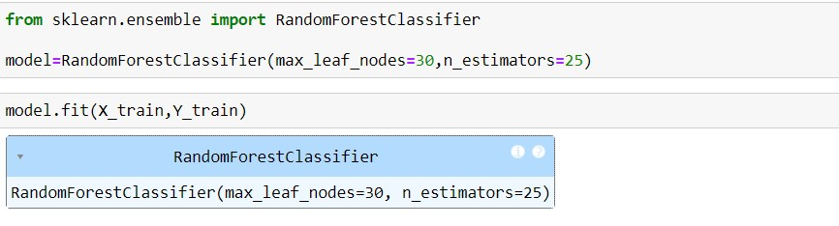
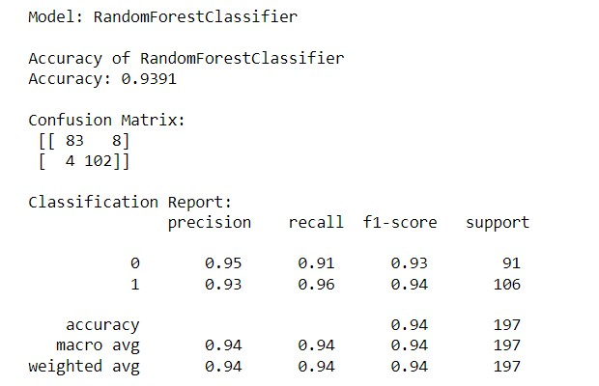
Random Forest

Slide 21
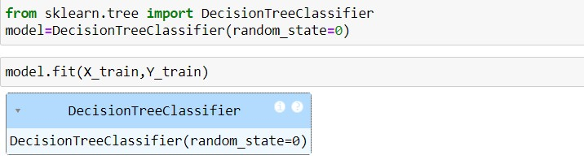
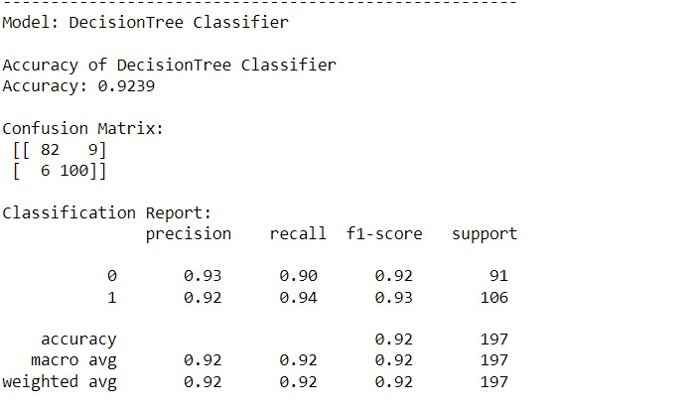

Slide 22
RESULTS & FUTURE SCOPE
RESULTS
FUTURE SCOPE
Basically, in our project we have 3 Modules.
Module 1: Analysis on Dataset
Module 2: Building Machine Learning Model and Performance Evaluation
Module 3: Created Web Application to demonstrate the result.
Advanced Machine Learning Models
Multimodal Data Integration
Early Detection and Intervention
Longitudinal Studies
Explainable AI in Healthcare

Slide 23
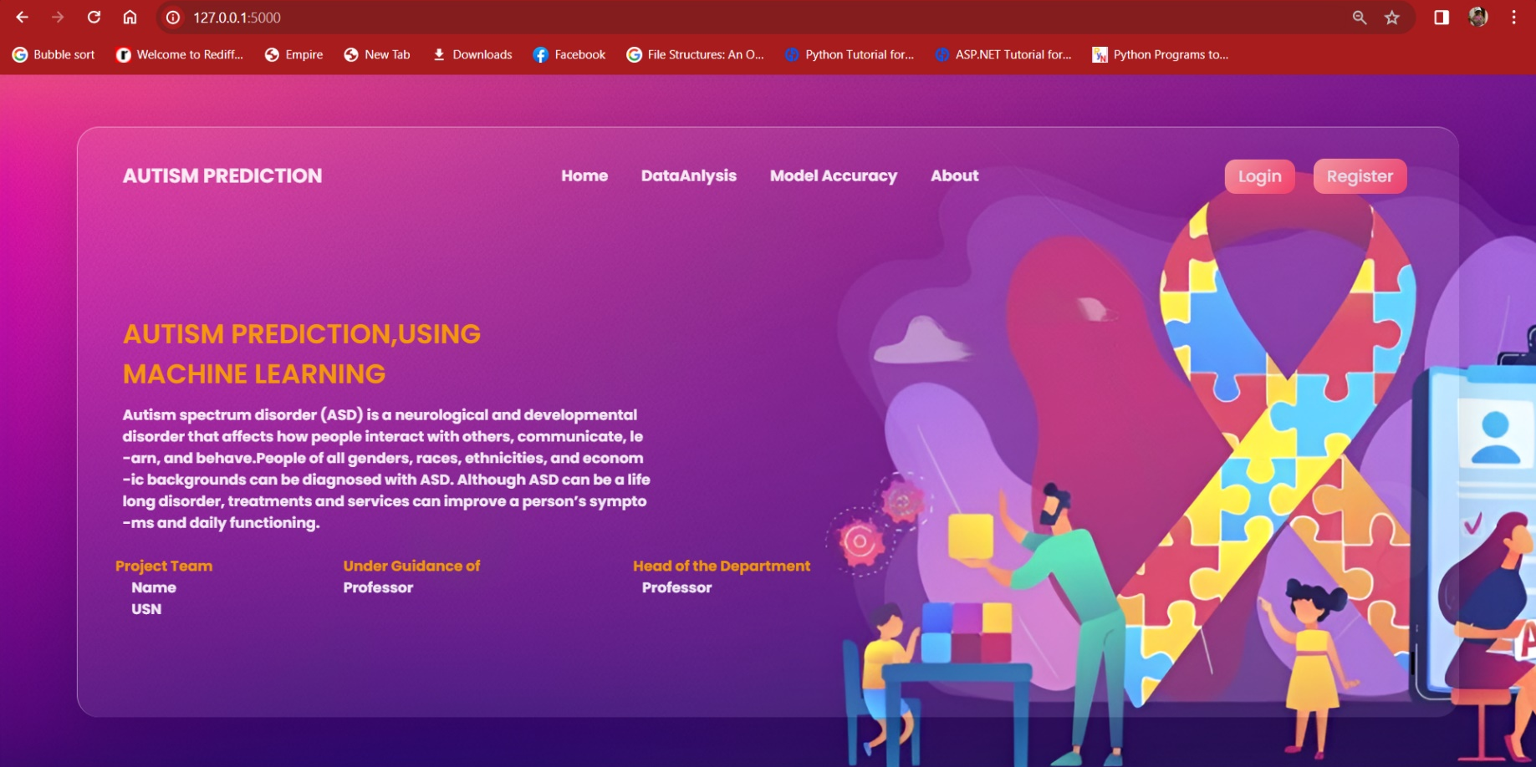
HOMEPAGE

Slide 24
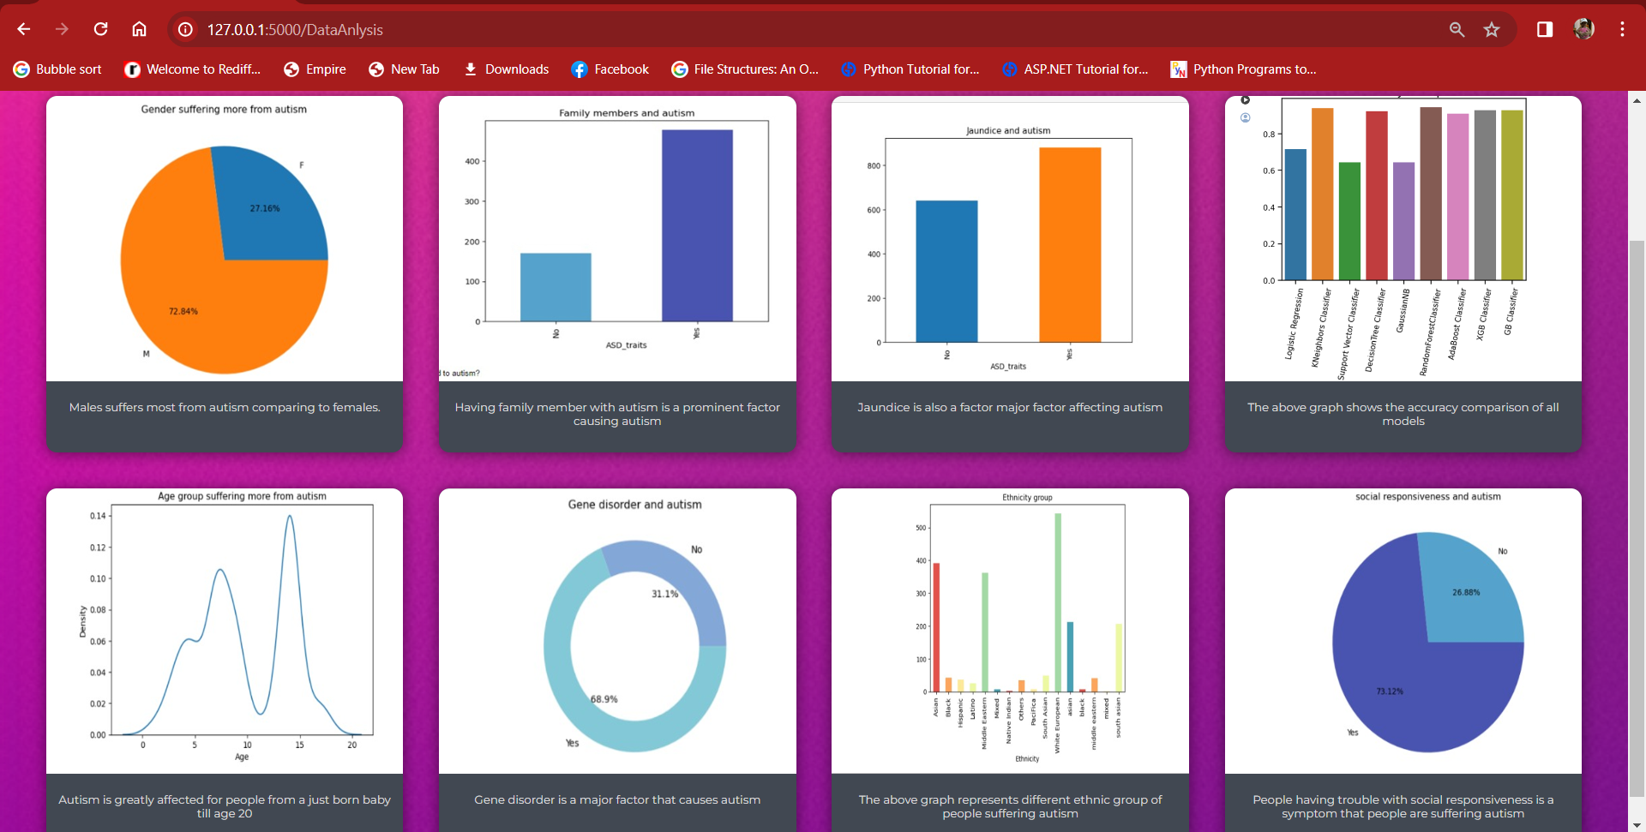
DATA ANALYSIS

Slide 25
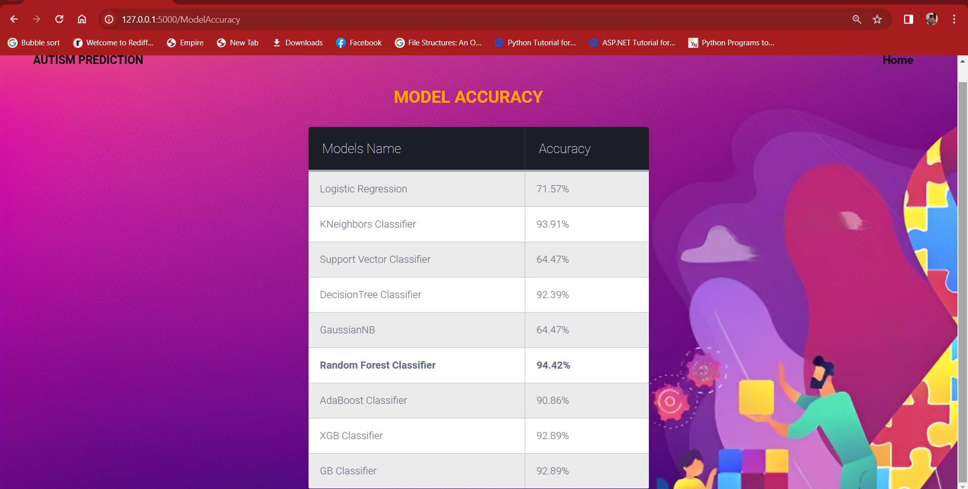
MODEL ACCURACY

Slide 26
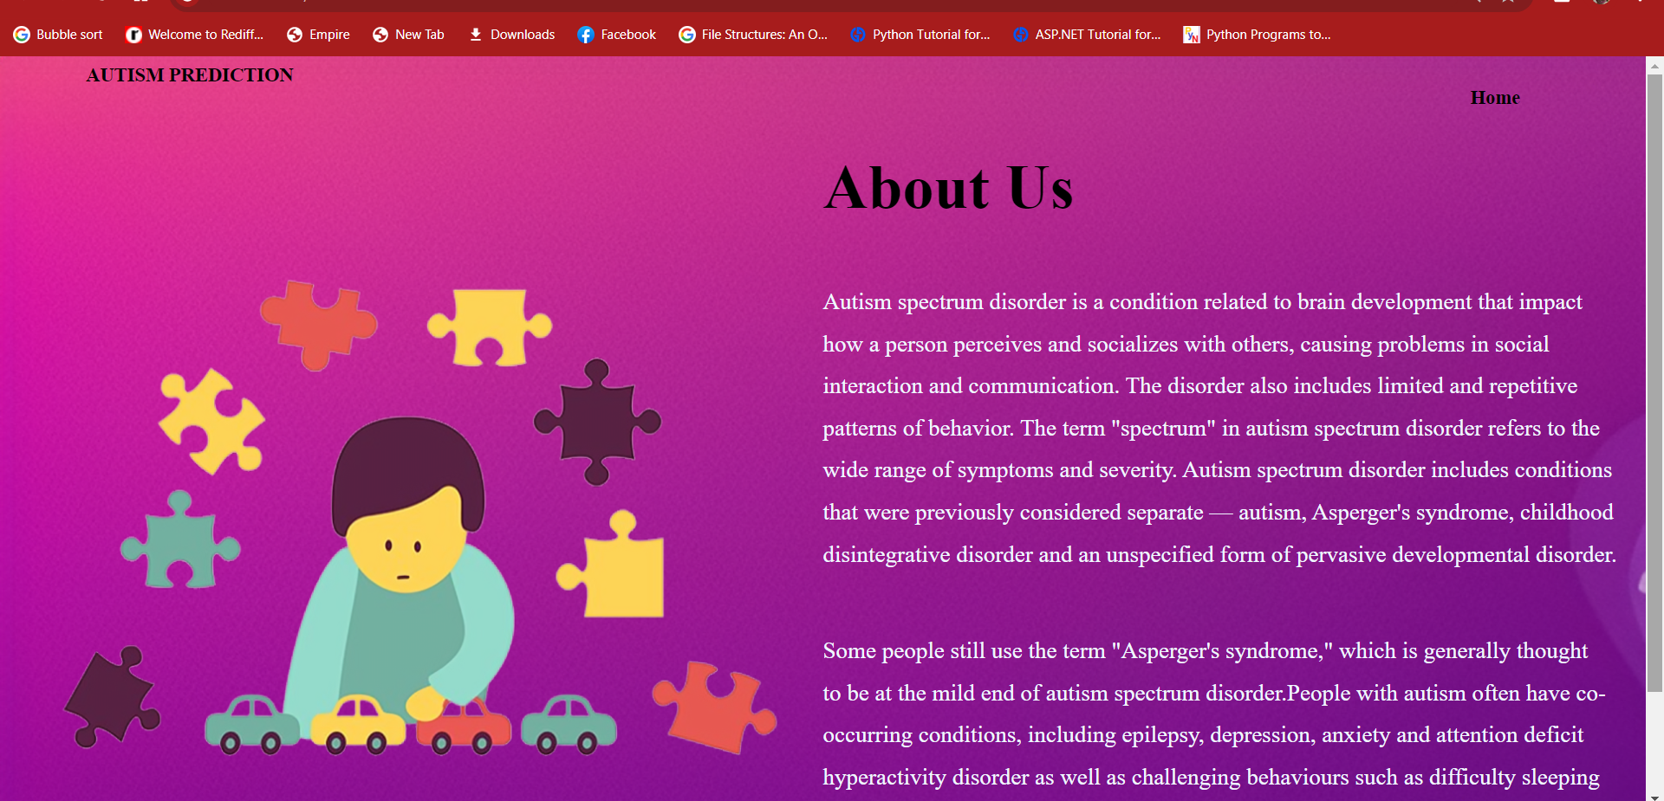
ABOUT US

Slide 27
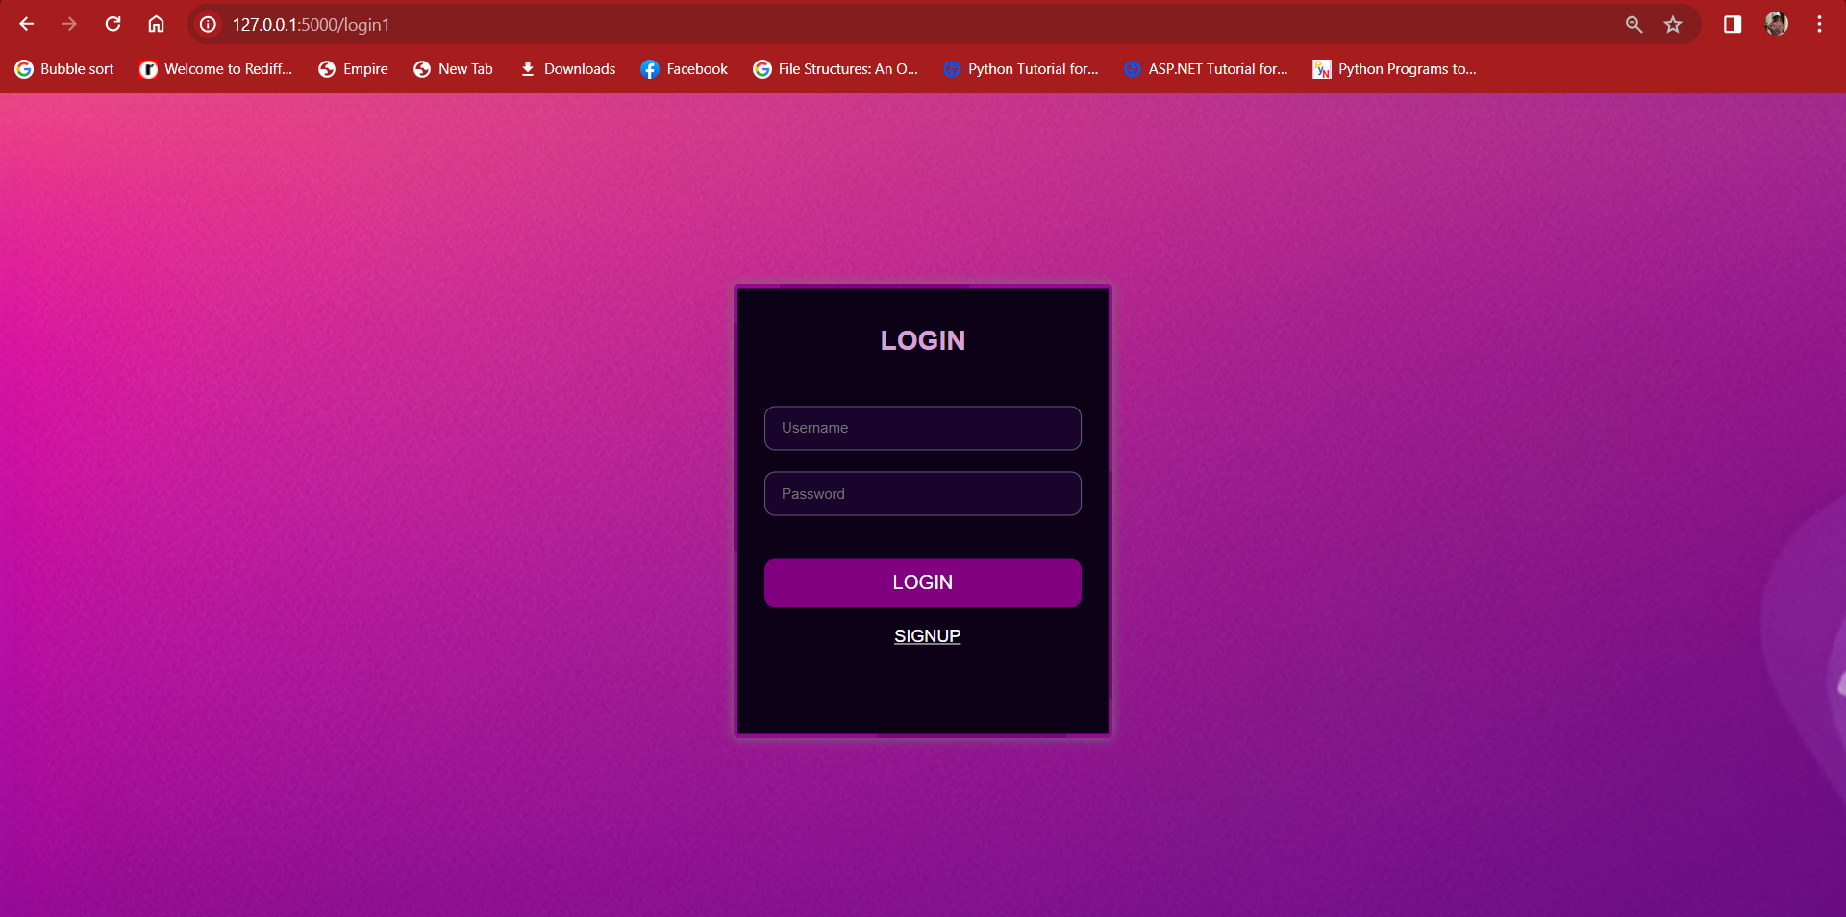
LOGIN MODULE

Slide 28
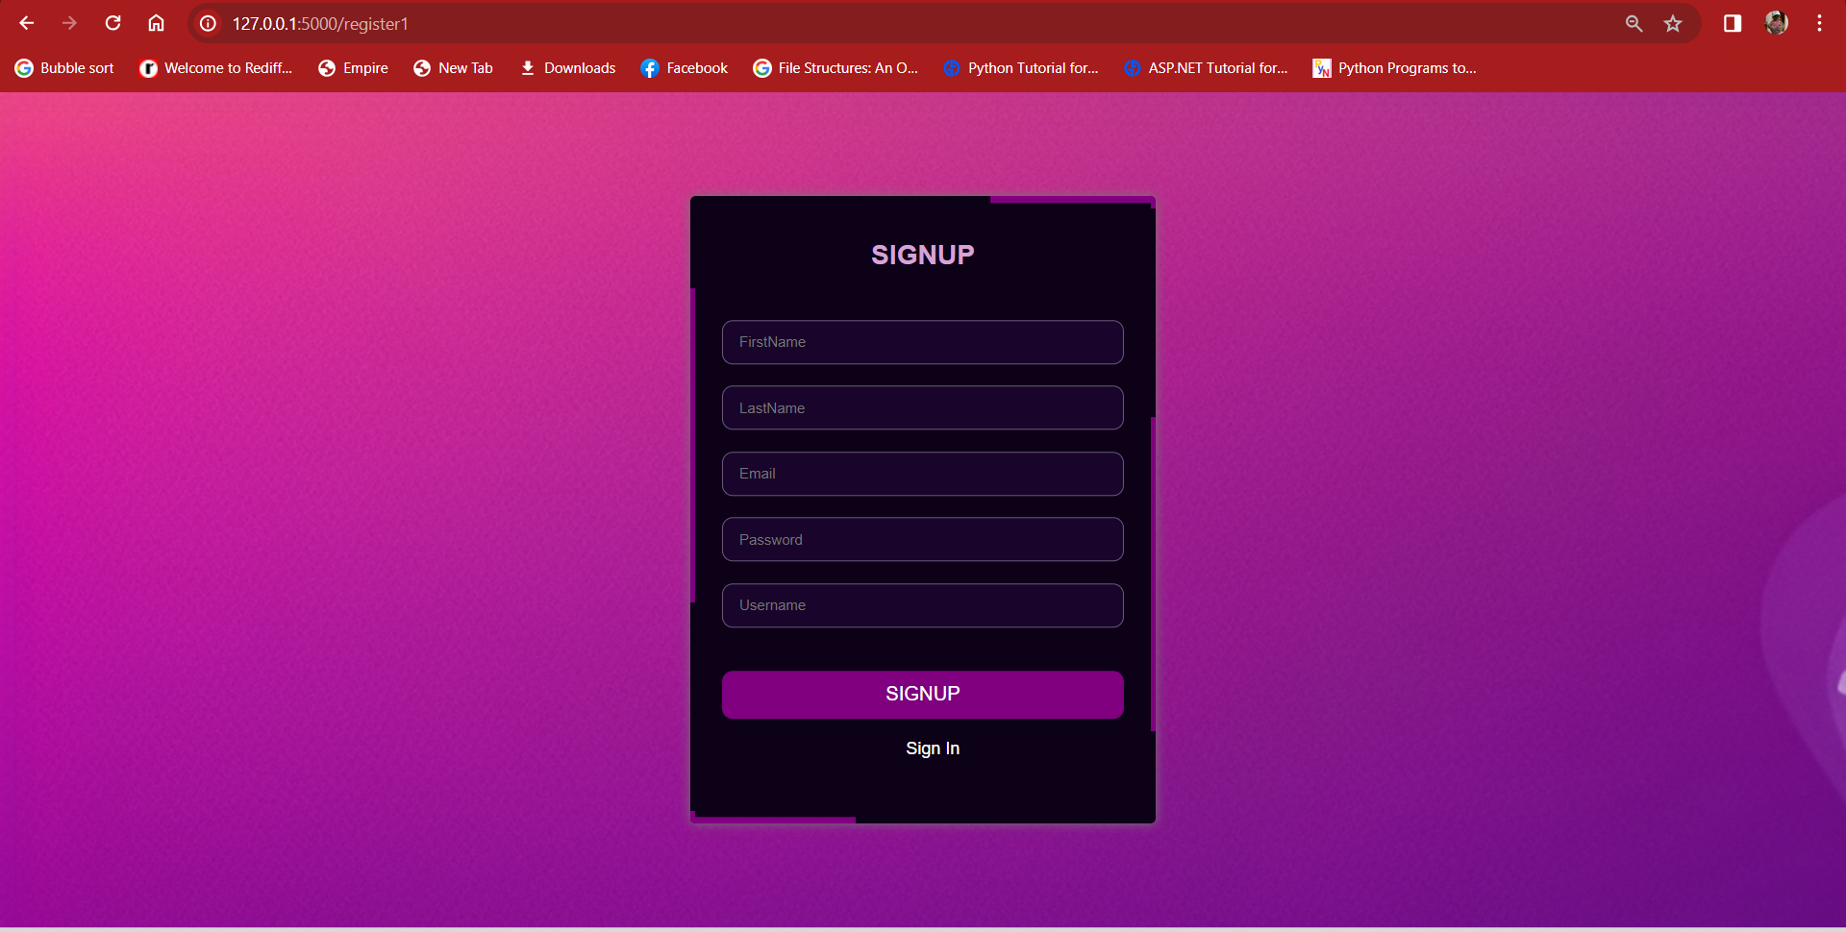
SIGN UP MODULE

Slide 29
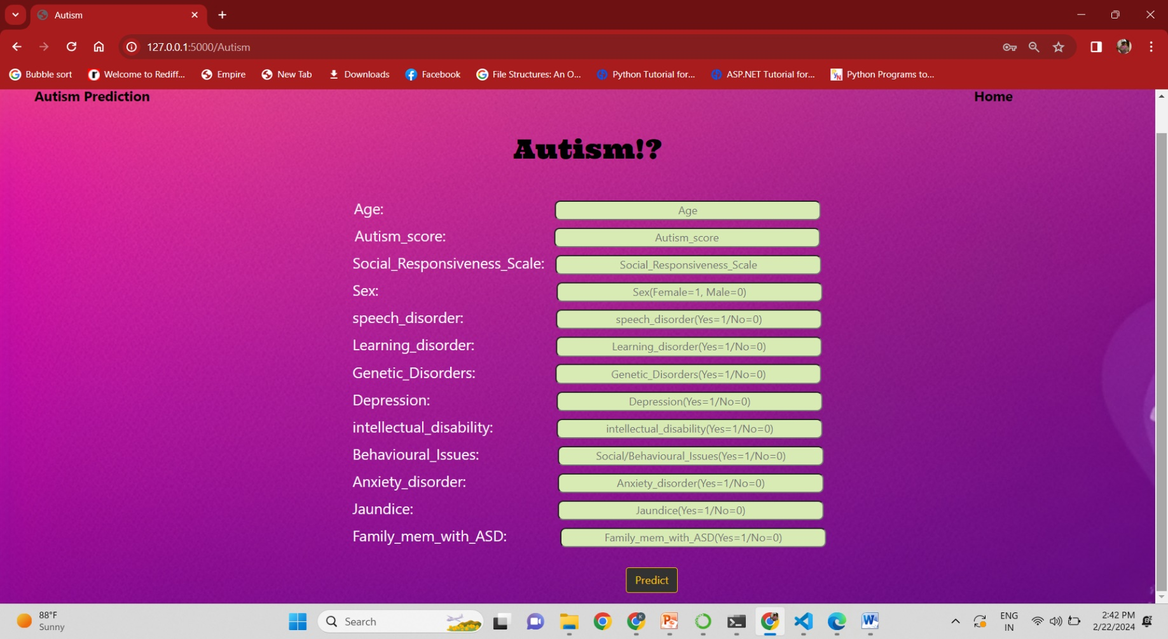
PREDICTION MODULE

Slide 30
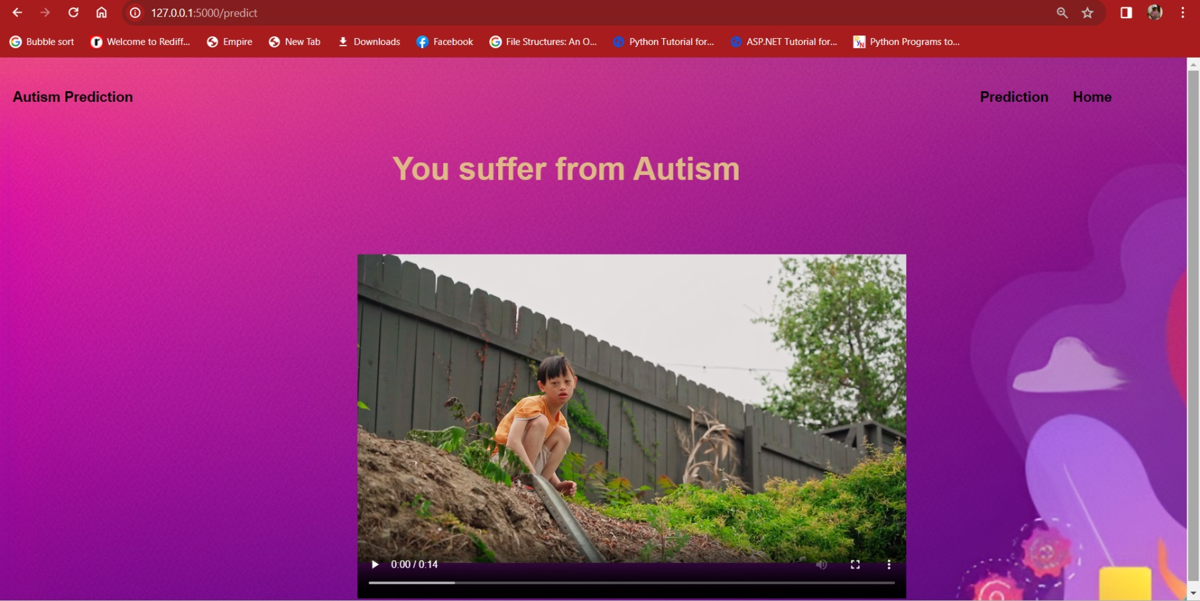
RESULT PAGE

Slide 31
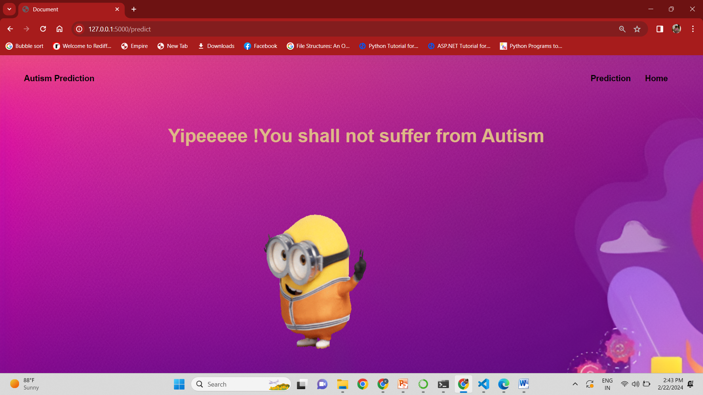
RESULT PAGE

Slide 32
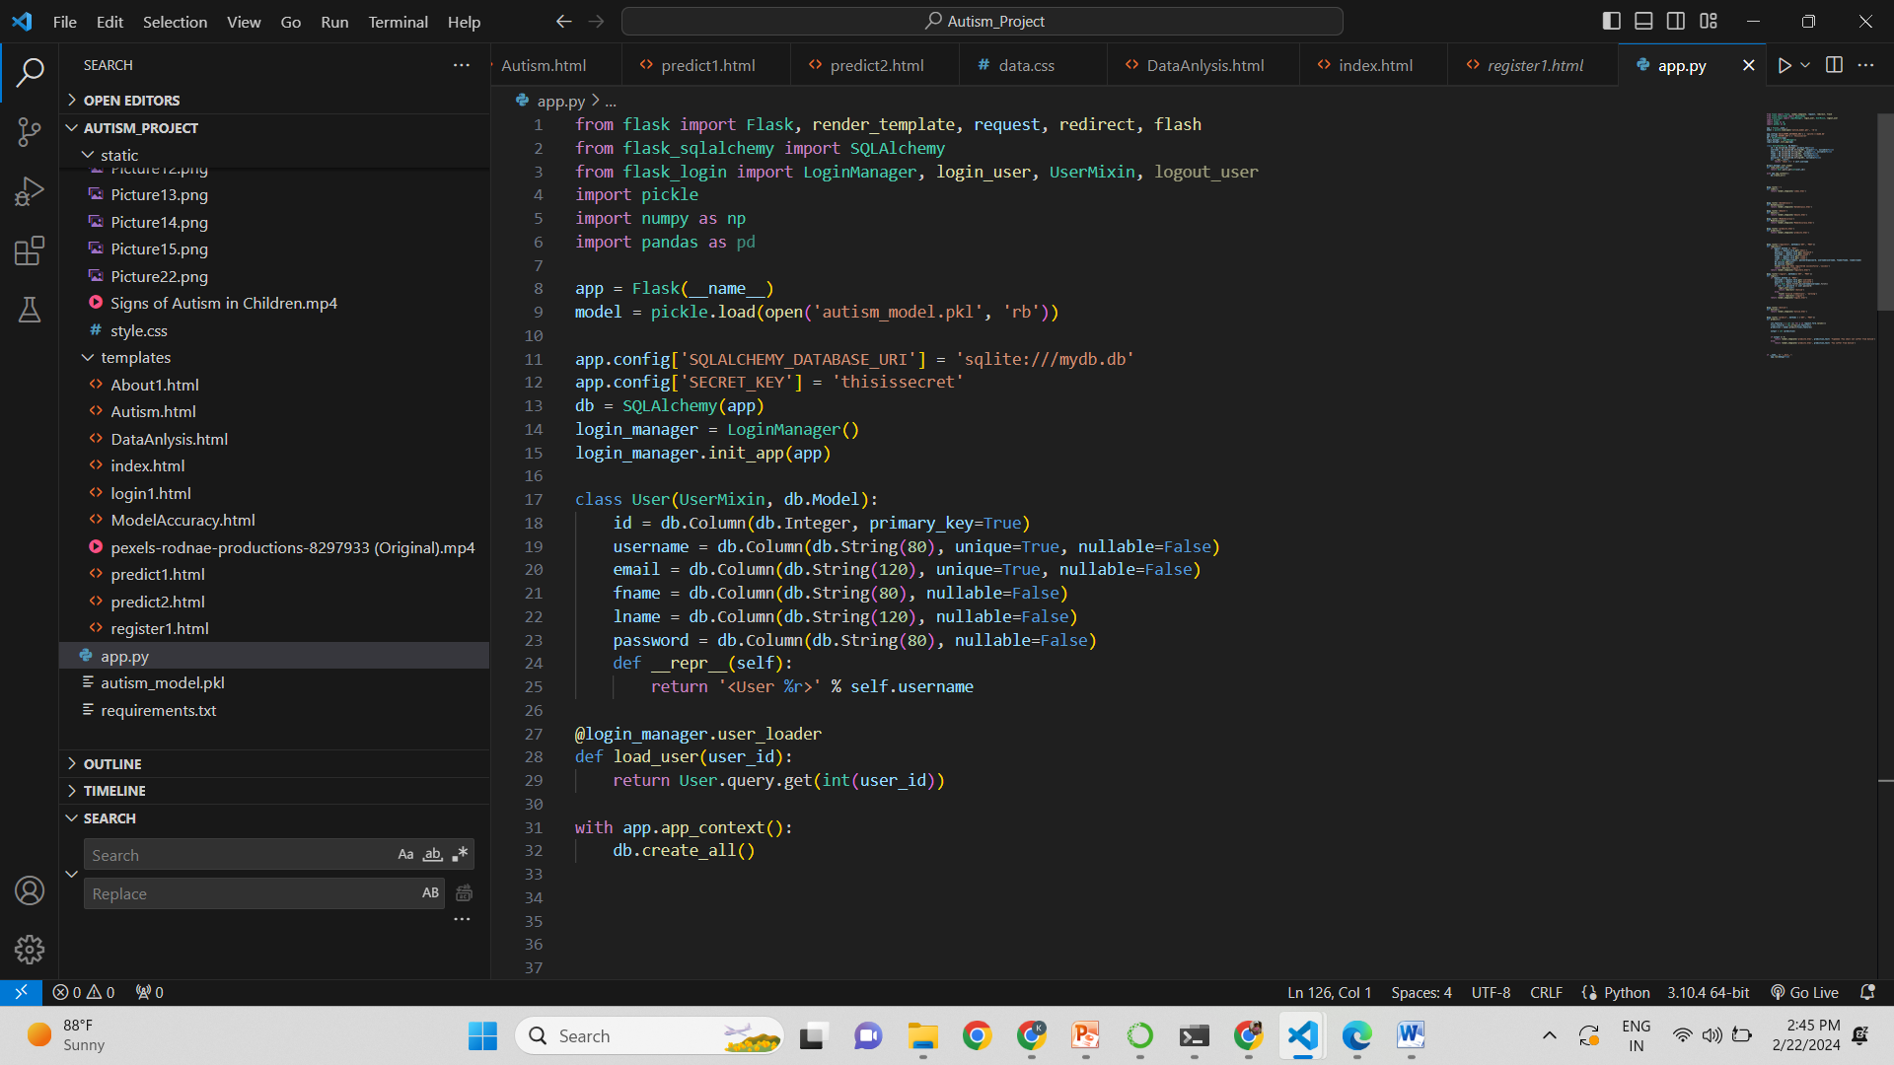

Slide 33
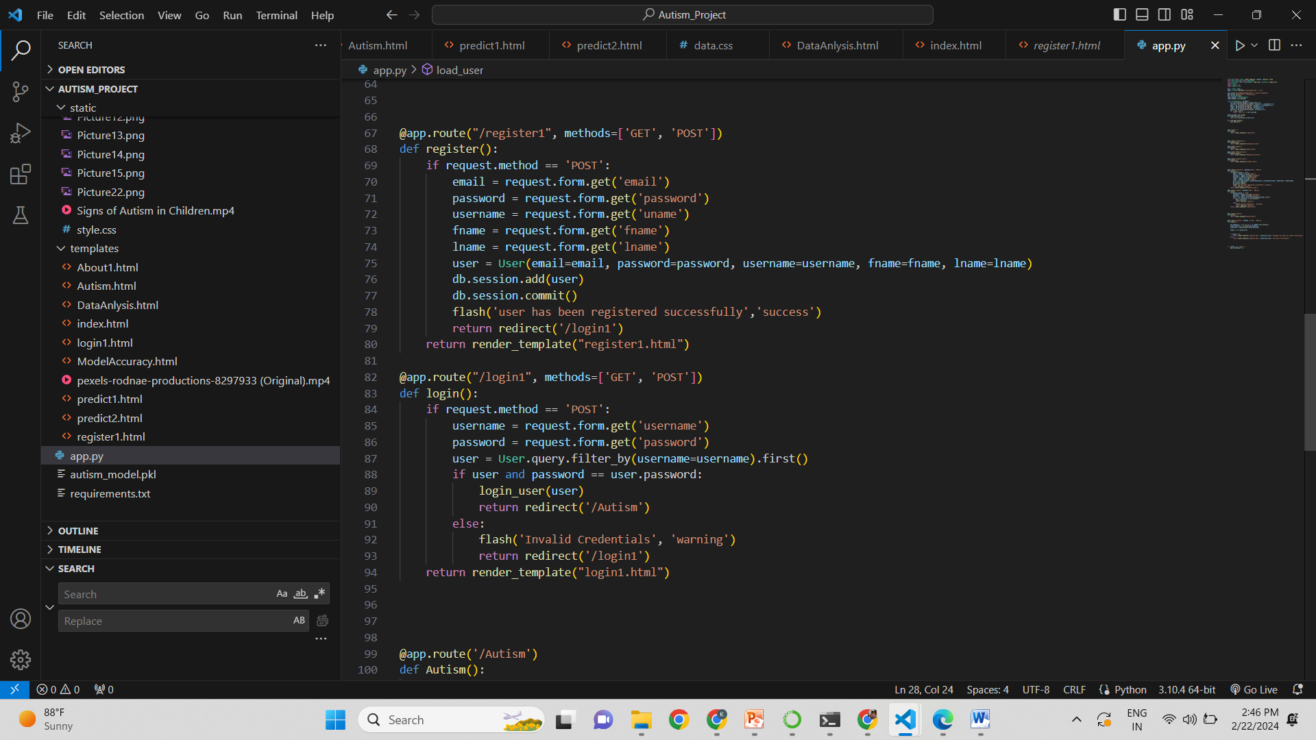

Slide 34
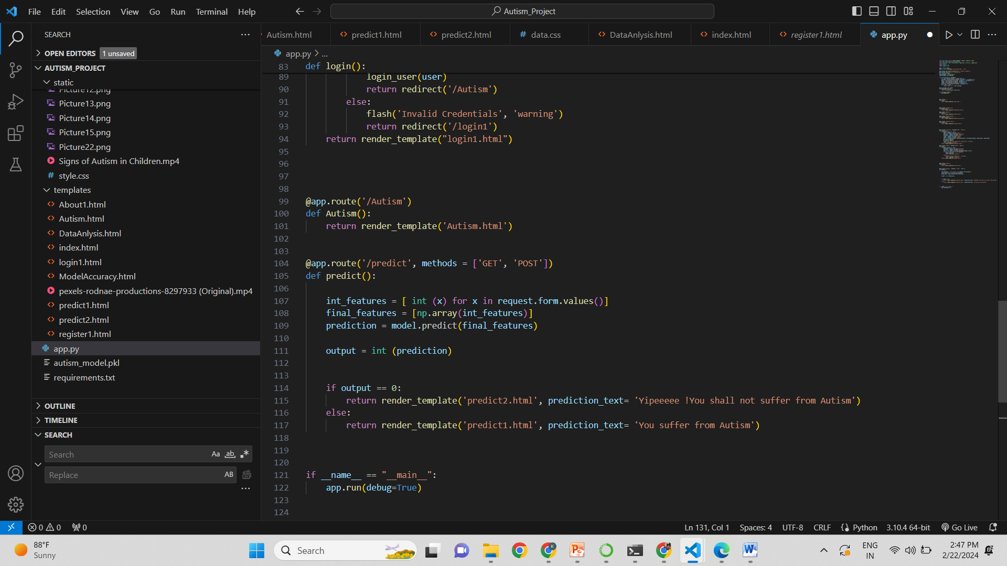

Slide 35
SYSTEM REQUIRMENT & SPECIFICATIONS
Software Requirements
Scripting language : Python Programming
Scripting Tool : Anaconda Navigator (Jupyter Notebook) or Google Colab
Operating System : Microsoft Windows 8/ 10 or 11
Dataset : UCI Machine Learning Repository - Autism Dataset
Machine Learning Packages : Numpy, Pandas, Matplotlib , Seaborn Packages etc..
Web Application Platform : Flask ( Python Full Stack Framework )
Hardware Requirements
Processor : 3.0 GHz and Above
Output Devices : Monitor (LCD)
Input Devices : Keyboard
Hard Disk : 1 TB
RAM : 8GB or Above

Slide 36
FUTURE SCOPE
The future scope of Autism Spectrum Disorder (ASD) detection holds promising opportunities for advancements in technology, research, and healthcare.
1. Advanced Machine Learning Models: Continued development of more sophisticated machine learning and deep learning models for ASD detection. This includes exploring architectures like transformers, attention mechanisms, and ensemble methods to improve accuracy.
2. Multimodal Data Integration: Integration of data from various sources, such as behavioural observations, speech patterns, neuroimaging, genetic data, and wearable devices. Multimodal data fusion can provide a more comprehensive understanding of ASD and enhance predictive models.
3. Early Detection and Intervention: Emphasis on early detection and intervention strategies. Leveraging machine learning to identify early signs of ASD in infancy or early childhood can significantly improve outcomes by facilitating timely intervention and support.
4. Longitudinal Studies: Conducting longitudinal studies to capture the developmental trajectories of individuals with ASD. Machine learning models can be trained on longitudinal data to identify patterns that may evolve over time, leading to more personalized interventions.
5. Explainable AI in Healthcare: Integration of explainable AI techniques to enhance the interpretability of ASD detection models. Understanding how models arrive at their predictions is crucial, especially in healthcare settings, where interpretability is essential for gaining trust from healthcare professionals.

Slide 37
CONCLUSION
The development of the Autism Spectrum Disorder Detection System marks a significant step forward in the realm of healthcare and technology.
Through the careful integration of machine learning algorithms, data analysis, and an extensive dataset, we have strived to create a tool that not only aids in the early diagnosis of Autism but also offers valuable insights for intervention and treatment strategies.
we recognize the immense potential it holds in improving the lives of individuals and families affected by Autism.
However, we also acknowledge the ongoing need for collaboration with healthcare professionals, ethical considerations, and continuous refinement to ensure its effectiveness and ethical use.
With a commitment to empathy, inclusivity, and rigorous research, we aspire to see this system contribute positively to the broader conversation surrounding Autism Spectrum Disorder diagnosis and care.
Our hope is that this project will serve as a catalyst for further innovation and support in the field of Autism research and assistance.

Slide 38
REFERENCES
1] Thabtah, Fadi. "Machine learning in autistic spectrum disorder behavioral research: A review and ways forward. (2018) " Informatics for Health and Social Care : 1-20.
[2] Thabtah, Fadi, Firuz Kamalov, and Khairan Rajab. (2018) "A new computational intelligence approach to detect autistic features for autism screening." International journal of medical informatics 117: 112-124.
[3] Vaishali, R., and R. Sasikala. "A machine learning based approach to classify Autism with optimum behaviour sets. (2018) " International Journal of Engineering & Technology 7(4): 18.
[4] Constantino, John N., Patricia D. Lavesser, Y. I. Zhang, Anna M. Abbacchi, Teddi Gray, and Richard D. Todd. (2007) "Rapid quantitative assessment of autistic social impairment by classroom teachers." Journal of the American Academy of Child & Adolescent Psychiatry 46(12): 1668-1676.
[5] Daniel Bone, Matthew S. Goodwin, Matthew P. Black, Chi-Chun Lee, Kartik Audhkhasi, and Shrikanth Narayanan. (2015) "Applying machine learning to facilitate autism diagnostics: pitfalls and promises." Journal of autism and developmental disorders 45(5): 1121-1136.

Slide 39
6] Dennis Paul Wall, J. Kosmicki, T. F. Deluca, E. Harstad, and Vincent Alfred Fusaro. (2012) “Use of machine learning to shorten observationbased screening and diagnosis of autism.” Translational psychiatry, 2(4): e100.
[7] Dennis P. Wall, Rebecca Dally, Rhiannon Luyster, Jae-Yoon Jung, and Todd F. DeLuca. (2012) “Use of artificial intelligence to shorten the behavioral diagnosis of autism.” PloS one, 7(8): e43855.
[8] Fadi Thabtah. (2017). “Autism spectrum disorder screening: machine learning adaptation and DSM-5 fulfillment.” In Proceedings of the 1st International Conference on Medical and Health Informatics, pp. 1-6. ACM.
[9] Daniel Bone, Chi-Chun Lee, Matthew P. Black, Marian E. Williams, Sungbok Lee, Pat Levitt, and Shrikanth Narayanan.(2014). “The psychologist as an interlocutor in autism spectrum disorder assessment: Insights from a study of spontaneous prosody.” Journal of Speech, Language, and Hearing Research, 57(4): pp.1162-1177. [10] Fadi Thabtah. (2017) “ASD Tests. A mobile app for ASD screening.” www.asdtests.com [accessed December 20th, 2017].
[10] Fadi Thabtah. (2017) “ASD Tests. A mobile app for ASD screening.” www.asdtests.com [accessed December 20th, 2017].

Slide 40
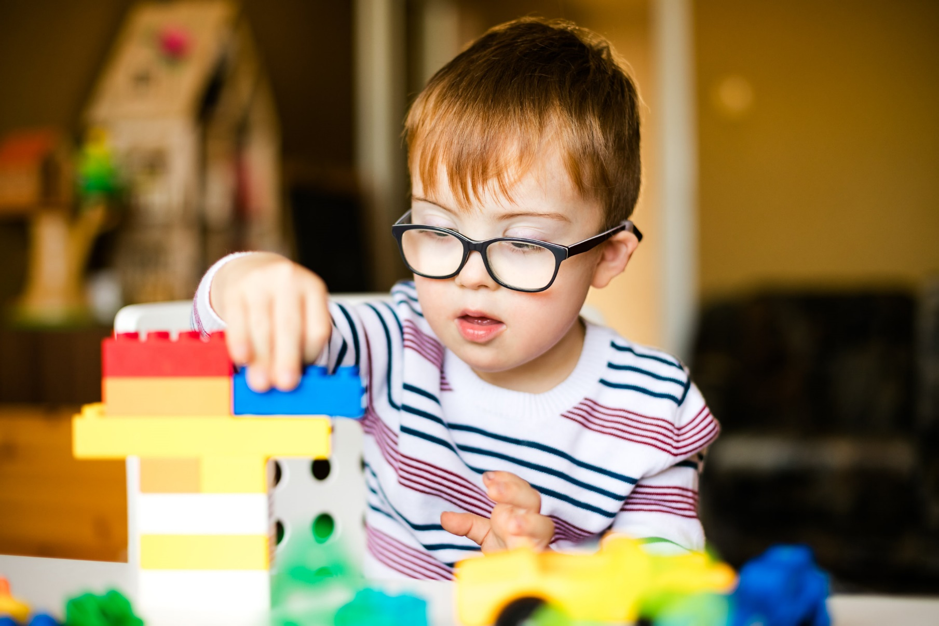
THANK YOU!
END SLIDE

